Slide 1

Gu et al. (2020,RFS): Empirical Asset Pricing via Machine Learning

Slide 2
Agenda of Gu et al. (2020, RFS)
• Data in a nutshell
• Learning in nutshell
• Machine learning algorithms under consideration
• Empirical findings

Slide 3
Data in a Nutshell
• Monthly individual equity returns from CRSP for all firms listed in NYSE, AMEX, NASDAQ
• 1957-2016
• On average 6,200 stocks per month (30,000 in total)
• Predictors:
• 94 stock characteristics, interacted with
• 8 aggregate variables (dividend yield etc) and
• 74 industry dummies
• Resulting in 900 baseline signals

Slide 4
Learing in a Nutshell
• Conceptual explanations
• Classical ML approaches are used to predict stock returns :E_t(R_i_tp1) = g(z_i_t; theta)
• Starting configuration:
• Tr: 1957-1974, 18 years
• Vald : 1975-1986, 12 years
• Test : 1987-2016, 12 years
• Models get re-trained once every year (starting 1987), increasing the
training set by 1 year, keeping validation set at 12 years and testing forecasts on next year‘s realized monthly returns

Slide 5






Conceptual explanations
• The definition of machine learning
The definition of machine learning in statistical prediction encompasses three core elements:
(a) a diverse collection of high-dimensional models for statistical prediction, combined with (b) so-called “regularization” methods for model selection and mitigation of overfit, and (c) efficient algorithms for searching among a vast number of potential model specifications.
• (a) High-Dimensional Models
The objective is to predict the target variable through a complex functional mapping
where X∈R represents the high-dimensional feature matrix, f(X) is a nonlinear mapping function, and ϵ denotes the error term.
• (b) Regularization Methods
To mitigate overfitting, a regularization constraint is added to the optimization objective:
• (c) Efficient Algorithms
Efficient algorithms are employed to search for the optimal model within the function space :
Heuristic methods or gradient-based optimization techniques (e.g., random forests, gradient boosting machines, neural networks) are used to approximate the optimal solution, significantly reducing computational complexity.

Slide 6
Conceptual explanations
• Why Apply Machine Learning Methods to Empirical Asset Pricing?
Three features of empirical asset pricing make it ideal for machine learning analysis:
• 1.The Predictive Power
First, the two core research agendas in asset pricing—explaining differences in expected returns across assets and analyzing the dynamics of the aggregate market equity risk premium—are fundamentally predictive problems. Machine learning is particularly well-suited to such tasks due to its strength in prediction.
• 2.Dimensionality
Second, the set of candidate predictors for risk premiums is vast, including hundreds of stock-level characteristics and dozens of macroeconomic variables documented in the literature. Traditional methods often struggle when the number of predictors approaches the number of observations or when predictors are highly correlated. Machine learning, with its emphasis on variable selection and dimension reduction, effectively addresses these challenges.
• 3.Flexibility
Finally, the functional forms through which high-dimensional predictors influence risk premiums are highly uncertain, encompassing possibilities such as linearity, nonlinearity, and interactions among predictors. Machine learning excels in handling such uncertainties with its methodological diversity, capability to model complex nonlinear relationships, and use of parameter penalization mechanisms, which collectively enable it to balance model flexibility with overfitting avoidance.

Slide 7
Framework
theoretical foundation
Assessing predictive power
model construction
the most general form
performance evaluation
Forecast comparison
g-function methods considered
Variable Importance and Marginal Relationships

Slide 8
Theoretical Foundation
How to Predict Asset Returns?
Characteristics-based asset pricing Link future stock returns to ex-ante characteristics derived from both stock-level features and macroeconomic variables.
Characteristics-based asset pricing refers to a method of explaining and predicting asset returns through specific characteristics of the assets, such as market capitalization, book-to-market ratio, momentum, volatility, etc. The core idea of this approach is that asset returns are determined not only by overall market factors but also by the significant influence of the assets' own characteristics.

Slide 9


Most general form
Defining the Asset’s Excess Return Prediction Model
g∗(⋅) Methods considered（References）： linear and nonlinear models.
ri,t+1​ represents the excess return of asset i at time t+1.
Et​(ri,t+1​) is the conditional expectation of future excess returns given the information set Ft at time t, often referred to as the risk premium.
εi,t+1​ denotes the prediction error or unpredictable random component, reflecting unanticipated market shocks.
zi,t​ is the vector of feature variables for asset i at time t.
g∗(⋅) is a general prediction function that maps the feature variables zi,t to the conditional expectation Et(ri,t+1).
The Most general form decomposes asset returns into two parts: the predictable component Et(ri,t+1) and the unpredictable component εi,t+1​. The core research objective is to accurately estimate Et(ri,t+1), and machine learning methods are applied to enhance this estimation.

Slide 10
Methods considered
Et​(ri,t+1​)=g∗(zi,t​)
linear models
OLS Regression
The weighted loss function(an extension of OLS)
The Huber loss function(a variant of OLS)
Elastic Net Regression
Principal Component Regression (PCR)
Partial Least Squares Regression (PLS)
nonlinear models
Random Forest
Boosted regression trees
Simple linear
Penalized Linear Models
Linear Dimension Reduction Techniques
Generalized Linear Regression
Tree-based Models
Neural Network

Slide 11





OLS Regression
g∗(zi,t​)
g(zi,t​;θ)
Objective function:
L(θ): The loss function, which measures the error between model predictions and actual returns. Specifically, it represents the mean squared error (MSE) of the predictions, serves as the optimization target, minimized to obtain the optimal parameter vector θ.
ri,t+1: The actual excess return of asset i at time t+1, serving as the prediction target.
N:The total number of assets in the sample.
T:The total number of time periods.
g(zi,t​;θ):Represents the prediction function used to forecast the excess return of asset i at time t+1.
zi,t′ :Denotes the inner product of the feature vector zi,t and the parameter θ, forming the linear model representation.
⋅
:Represents the explicit expansion of the inner product, illustrates that the predicted value g(zi,t;θ); g(zi,t​;θ) is obtained by weighting each feature zi,t with its corresponding coefficient θ and summing the results.
j : the index of the feature, ranging from 1 to P.
zi,t,j : the value of the j-th feature.
θj : the regression coefficient for the j-th feature.

Slide 12
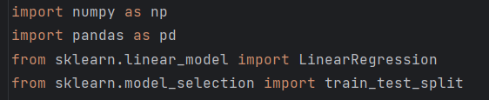
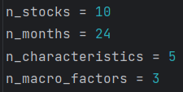
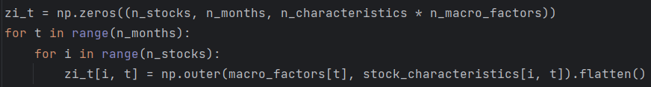
Python Explanation-OLS Regression
• Import library
• Generate synthetic sample data
• Generate stock characteristics (ci,t)
• Generate macroeconomic factors (xt)
• Generate interaction variables (zi,t)
Import the NumPy library for scientific computing
Import the Pandas library for data processing and analysis
Import the Linear Regression model from the Scikit-learn library
Import the train-test split function from the Scikit-learn library
Define the number of stocks as 10
Define the number of months as 24
Define the number of characteristics per stock as 5
Define the number of macroeconomic factors as 3
Set the random seed to ensure reproducibility
Generate random stock characteristics data
Generate random macroeconomic factors data
Initialize the zi_t matrix
Iterate through all months
Iterate through all stocks
Compute the outer product of macro factors and stock characteristics

Slide 13
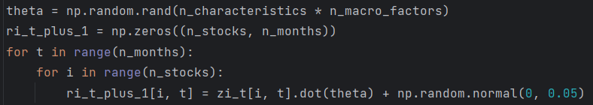

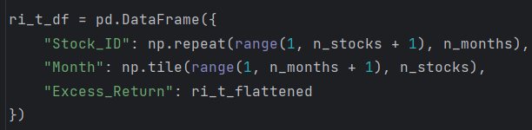
Python Explanation-OLS Regression
• Define a simple linear model for excess returns (ri,t+1)
• Flatten data for further analysis
• Combine data for regression
theta Generate a random parameter vector theta
Initialize the excess return matrix
Iterate through all months
Iterate through all stocks
Calculate excess returns based on the linear model and add random noise
Flatten the zi_t matrix
Flatten the ri_t+1 matrix
Create a DataFrame
Add Stock ID column
Add Month column
Create a DataFrame for excess returns
Add Stock ID column
Add Month column
Add excess return column
Combine zi_t and ri_t_plus_1 data

Slide 14


Python Explanation-OLS Regression
• Split the dataset into training and testing sets
• Split the dataset into training and testing sets
• Train OLS regression model
• Evaluate the model
Extract predictor variables
Extract the target variable
Split 70% of data for training/validation and 30% for testing
Further split the training/validation set to get approximately 20% for validation
Initialize the Linear Regression model
Fit the model
Generate predictions using the test dataset

Slide 15
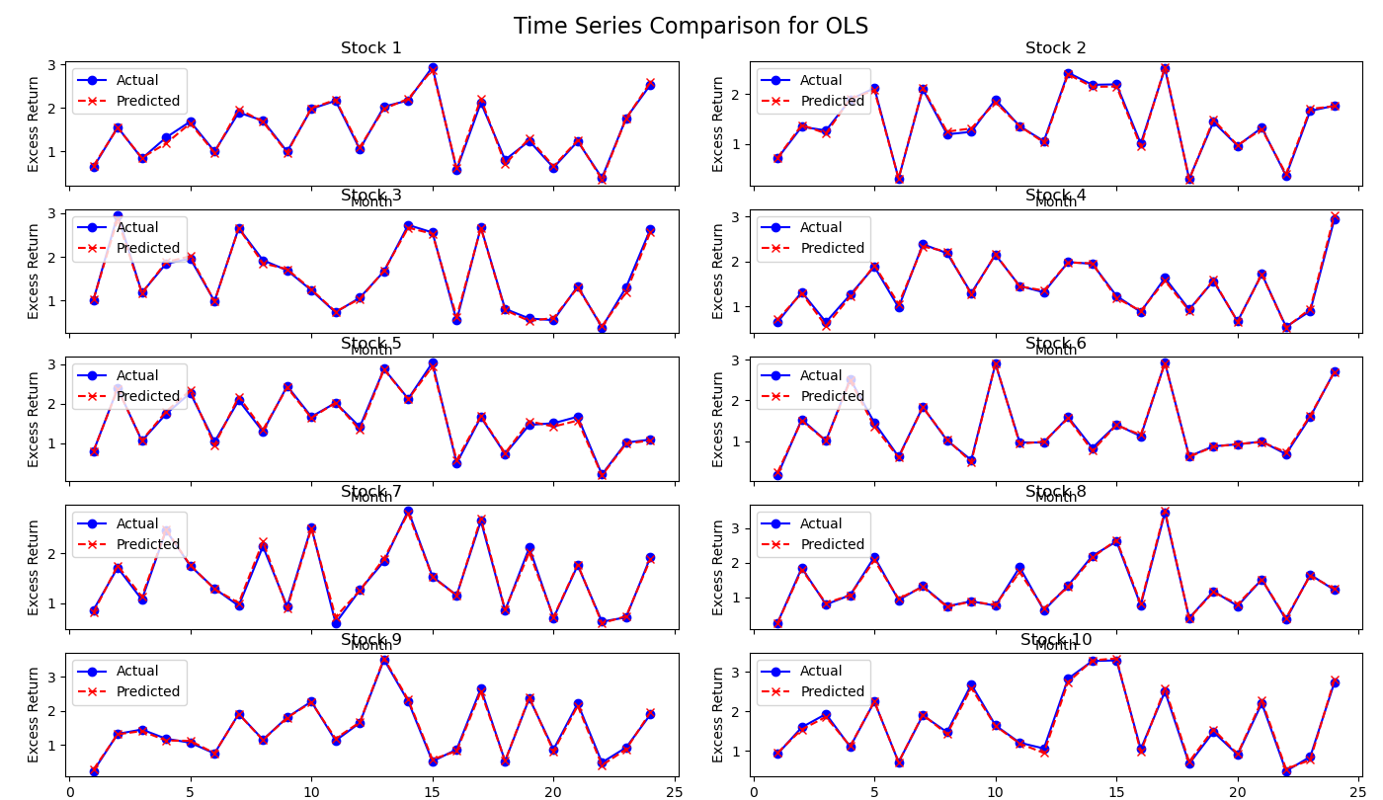
OLS Regression Results for Stock Return Prediction: A Time Series Analysis of the generated Sample Data

Slide 16
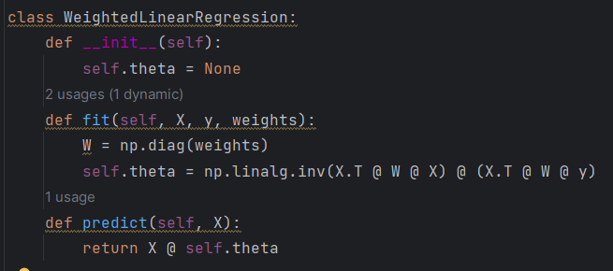


an extension of OLS
g∗(zi,t​)
g(zi,t​;θ)
Objective function:
L_{W​}(θ):The weighted loss function, which allows observations to contribute differently to the overall error.
wi,t:Weights assigned to individual observations, reflecting their importance. These weights can be based on factors such as time period, asset size, or statistical properties like variance.
Theta is obtained through the weighted normal equation.
The Equation is an extension of OLS with weights wi,t. This allows the model to emphasize certain observations while de-emphasizing others, providing flexibility in handling heterogeneous data, such as prioritizing large-cap stocks or balancing observations across time periods.

Slide 17

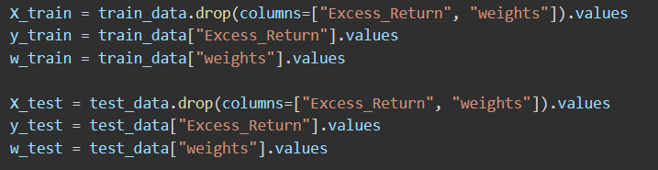
Python Explanation-an extension of OLS
• Import library
• The sample data construction part is the same as the OLS part.
• Create a DataFrame for modeling
• Extract predictors, target, and weights
Import NumPy library for numerical computation
Import Pandas library for data processing
Import function to split dataset into training and testing sets
Create DataFrame containing interaction variables, each column represents an interaction factor
Add excess return column
Generate random weights
Extract predictor matrix for training set
Extract target variable (excess return) for training set
Extract sample weights for training set
Extract predictor matrix for test set
Extract target variable (excess return) for test set
Extract sample weights for test set

Slide 18
Python Explanation-an extension of OLS
• Define the weighted loss function
• Define the weighted loss function
• Train the weighted linear regression model
• Predict on the test dataset
Initialize model parameters as None
Solve parameters using the weighted normal equation
Create diagonal weight matrix
Calculate parameters
Make predictions using model parameters
Create model instance
Fit model using training data
Generate predictions

Slide 19
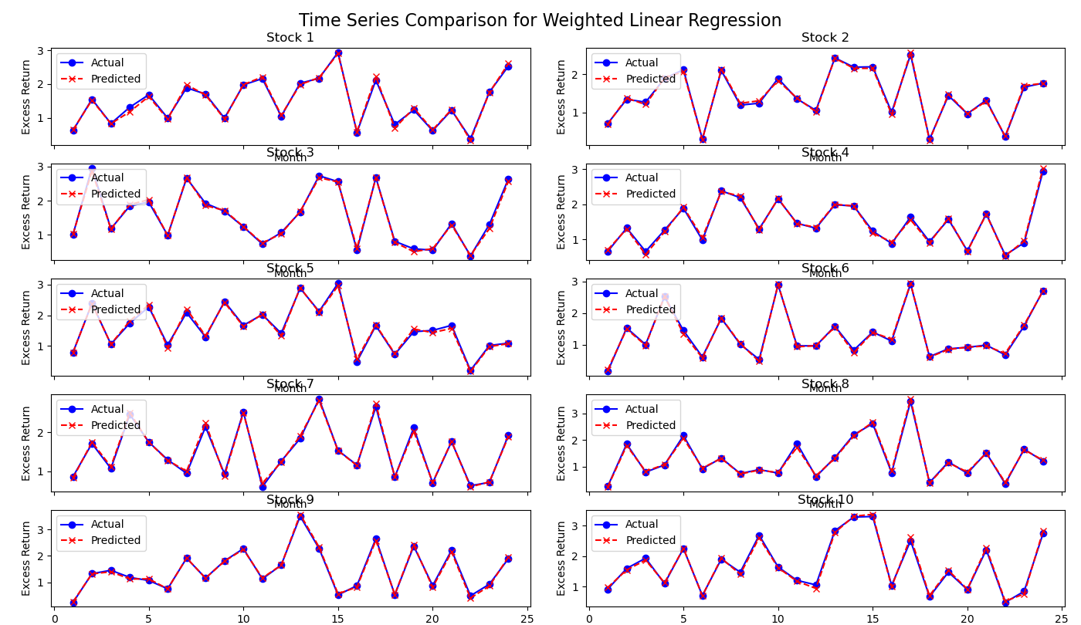
An extension of OLS Regression Results for Stock Return Prediction: A Time Series Analysis of the generated Sample Data

Slide 20
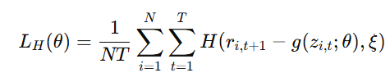
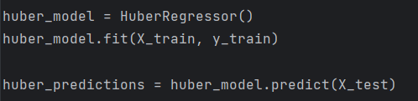
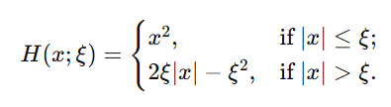
a variant of OLS
g∗(zi,t​)
g(zi,t​;θ)
Objective function:
L_{H​}(θ):The Huber loss function, which combines the advantages of mean squared error (MSE) and mean absolute error (MAE).
H(x;ξ):The Huber loss function form:
For small residuals (|x| ≤ξ), it uses squared error to retain efficiency.
For large residuals (|x| > ξ), it uses absolute error to reduce sensitivity to outliers.
ξ:A tuning parameter that controls the threshold between squared and absolute error regimes.
The equation defines a robust loss function, minimizing the impact of extreme observations (outliers) on the model. For small errors, it behaves like MSE to preserve estimation efficiency, while for large errors, it switches to MAE to mitigate the influence of outliers.

Slide 21
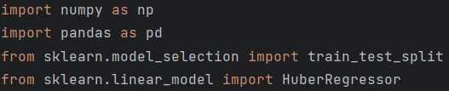

Python Explanation-a variant of OLS
• Import library
• The sample data construction part is the same as the OLS part.
• Train using Huber loss function
• Make predictions
Import NumPy library for numerical computations
Import Pandas library for data handling and analysis
Import function to split data into training and testing sets
Import Huber Regressor
Create Huber regression model instance
Fit model to training data
Predictions from Huber model

Slide 22
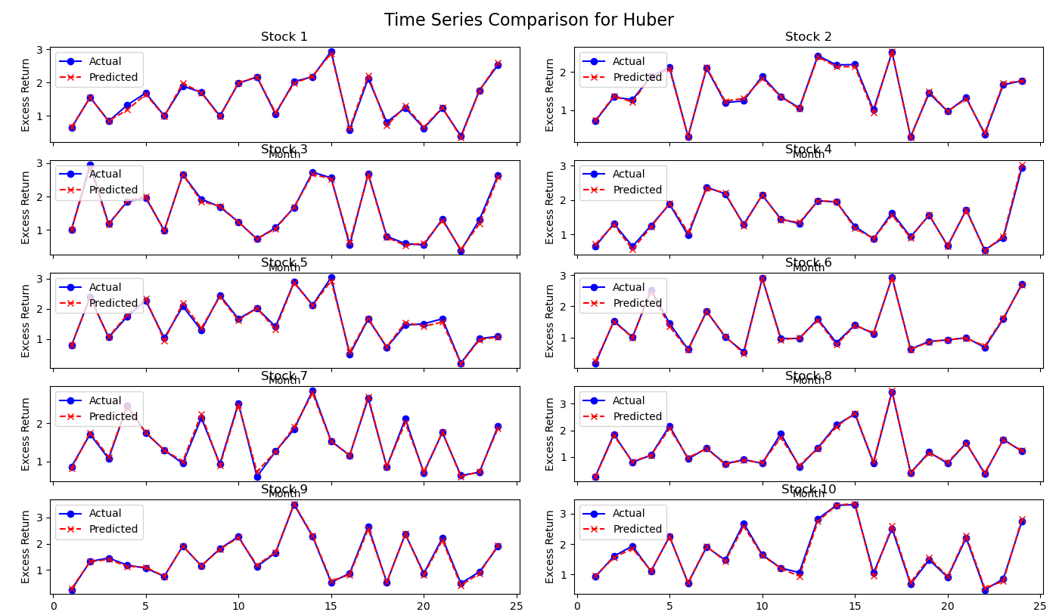
A variant of OLS Results for Stock Return Prediction: A Time Series Analysis of the generated Sample Data

Slide 23




g∗(zi,t​)
g(zi,t​;θ)
Elastic Net Regression
Objective function:
L(θ):The base loss function, which measures prediction error, such as Mean Squared Error (MSE) or robust alternatives like the Huber loss function.
ϕ(θ;⋅):The penalty function, used for model regularization by introducing bias to reduce sensitivity to noise. The specific form depends on the choice of regularization method.
λ:The regularization strength parameter. Larger λ values impose stronger penalties, further shrinking parameter values and reducing model complexity.
ρ:The mixing parameter that determines the relative weights of L1(lasso) and L2(ridge) penalties:
When ρ=0, only L1 penalty is retained, resulting in pure lasso regression, which achieves feature selection by shrinking some parameters to exactly zero.
When ρ=1, only L2 penalty is retained, resulting in pure ridge regression, which reduces parameter magnitudes without driving them to zero.
P:The number of predictors or features.
: The L1(lasso) component tends to reduce unimportant or redundant feature coefficients to zero, effectively selecting a subset of features that are most useful for prediction.
: The L2(ridge) component, which controls the absolute values of parameters to prevent them from becoming excessively large.

Slide 24
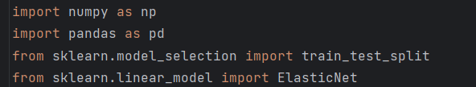
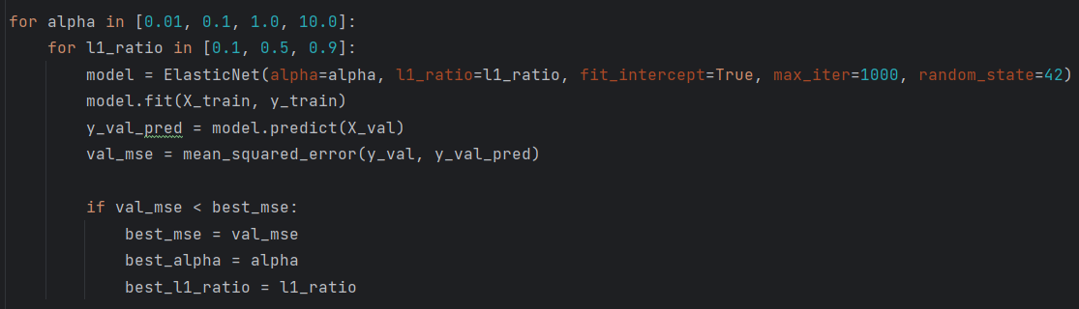
Python Explanation-Elastic Net Regression
• Import library
• The sample data construction part is the same as the OLS part.
• Hyperparameter tuning using validation set
Import the numpy library for numerical computations and data generation
Import the pandas library for data manipulation and creating dataframes
Import train_test_split for splitting datasets
Import ElasticNet for implementing Elastic Net regression
Candidate values for regularization strength
Candidate values for L1/L2 mixing parameter
Initialize Elastic Net model for regression
Train model on training set
Predict on validation set
Calculate validation set MSE
Update best hyperparameters if current MSE is lower
Update best MSE value
Update best alpha value
Update best l1_ratio value

Slide 25
Python Explanation-Elastic Net Regression
• Train final model with best hyperparameters from validation set
• Evaluate the model on the test set
Initialize the final Elastic Net model with best hyperparameters
Train the final model on the training set
Make predictions on the test set

Slide 26
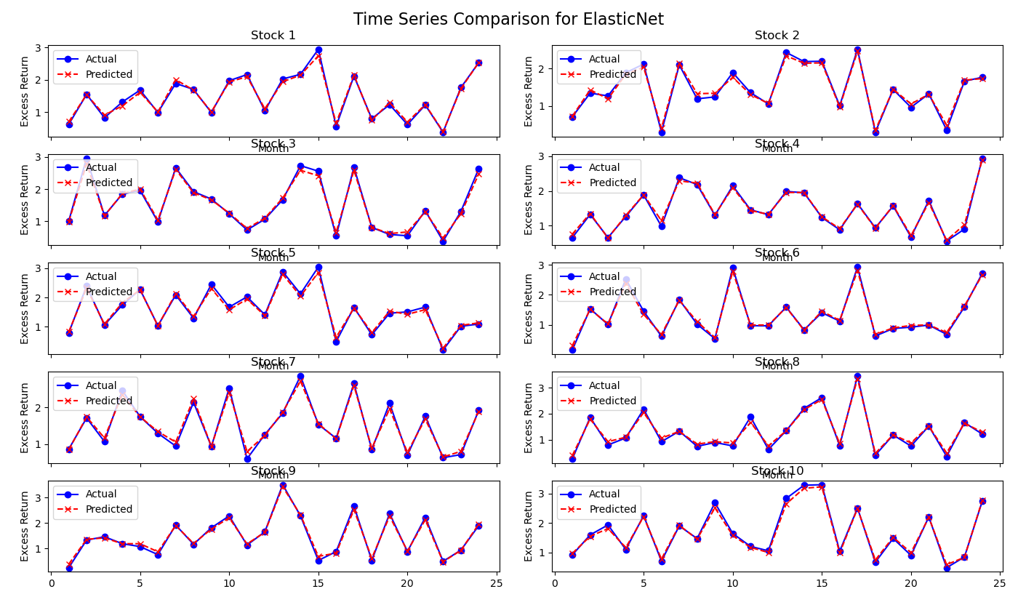
Elastic Net Regression Results for Stock Return Prediction: A Time Series Analysis of the generated Sample Data

Slide 27





Principal Component Regression (PCR)
g∗(zi,t​)
g(zi,t​;θ)
Partial Least Squares Regression (PLS)
Steps:
Step 1: Define the Linear Model
To extract key information from the predictors by calculating components via PCR or PLS, emphasizing variance (PCR) or predictive relevance (PLS).
R: A NT×1 vector of realized excess returns, containing all assets i and time periods t with observations ri,t+1.
Z: A NT×P predictor matrix, where each row corresponds to the P-dimensional predictor vector zi,t for a specific asset i at time t.
θ: A P×1 vector of regression coefficients.
E: A residual vector of size NT×1, representing deviations between predicted and actual returns.
The equation expresses the linear regression model in a compact matrix form. This serves as the foundational setup for applying dimensionality reduction techniques like PCR and PLS.
Step 2: Perform Dimensionality Reduction
ZΩ_{K​}: The dimension-reduced version of Z, projected onto a K-dimensional linear subspace using Ω_{K}.
Ω_{K}: A P×K dimensionality reduction matrix, defining the K linear combinations of predictors.
θ_{K}: A K×1 vector of regression coefficients for the dimension-reduced predictors.
E~: Residuals in the dimension-reduced model.
To reduce feature redundancy and multicollinearity while retaining the most important predictive information.
Compute the reduction matrix ΩK to project Z onto a lower-dimensional subspace.
For PCR, compute principal components by maximizing the variance of Zw.
For PLS, compute components that maximize the correlation with R.
Transform Z into its reduced form ZΩ_{K} using the projection matrix.

Slide 28
Principal Component Regression (PCR)
g∗(zi,t​)
g(zi,t​;θ)
Partial Least Squares Regression (PLS)
Steps:
Step 3: Determine Combination Weights for Predictors
For PCR:
w_{j​}:The j-th principal component weight vector.
Var(Z_{w}):The variance of the linear combination Zw, representing the amount of information captured by this component.
Cov(Z_{w},Z_{wl}):Ensures orthogonality among the principal components.
Goal: Maximize the variance explained by each principal component Zwj​.
Use singular value decomposition (SVD) to compute eigenvectors corresponding to the largest eigenvalues of Z′Z.
Construct ΩK by stacking the top K eigenvectors.
PCR seeks the linear combinations of Z (principal components) that maximize the variance while ensuring that each new component is orthogonal to the previous ones. The solution to this optimization is typically obtained via singular value decomposition (SVD).

Slide 29
Principal Component Regression (PCR)
g∗(zi,t​)
g(zi,t​;θ)
Partial Least Squares Regression (PLS)
Steps:
Step 3: Determine Combination Weights for Predictors
For PLS:
Cov2(R,Zw):The squared covariance between the target variable R and the linear combination of predictors Zw.
Cov(Zw,Zwl): Ensures orthogonality among components, similar to PCR.
Goal: Maximize the squared covariance between predictors and the target R.
Compute weights wj that emphasize predictors most correlated with R. Orthogonalize Z with respect to previously selected components to ensure independence.
PLS maximizes the predictive association between the reduced-dimension predictors Zw and the target variable R. Unlike PCR, which focuses on capturing the variance within predictors, PLS emphasizes predictors that are most relevant for predicting R.

Slide 30






Principal Component Regression (PCR)
g∗(zi,t​)
g(zi,t​;θ)
Partial Least Squares Regression (PLS)
Steps:
Step 4: Perform Regression on Dimension-Reduced Predictors
θ_{K​}:Regression coefficients for the dimension-reduced predictors, estimated by minimizing residuals.
Residual Sum of Squares (RSS):The sum of squared differences between observed and predicted returns, minimized to fit the model.
Perform Ordinary Least Squares (OLS) regression on the reduced predictors ZΩ_{K}.Solve R∼(ZΩK) to estimate θ_{K}.
To fit the regression model using dimension-reduced predictors, achieving an optimal relationship between predictors and returns.
Step 5: Make Predictions Using the Dimension-Reduced Model
θ^^{K​}:The estimated regression coefficients from the reduced model.
R^:The predicted excess returns for all assets and time periods.
Multiply ZΩ_{K} by the estimated coefficients θ^. Compute R^ as the predicted returns for future periods.
To use the regression model for forecasting future returns based on dimension-reduced predictors.

Slide 31
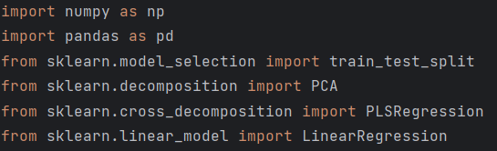
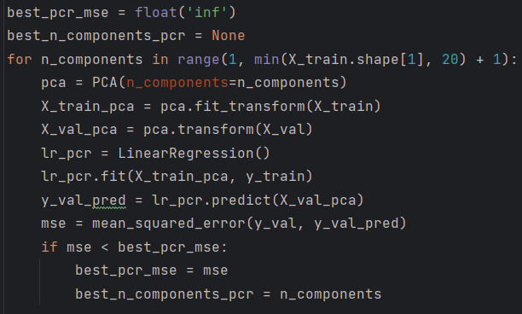
Python Explanation-Principal Component Regression (PCR)/Partial Least Squares Regression (PLS)
• Import library
• The sample data construction part is the same as the OLS part.
• Hyperparameter tuning and Principal Component Regression (PCR)
Import numpy for numerical operations
Import pandas for data manipulation
Import train_test_split from sklearn for splitting the dataset
Import PCA for principal component analysis
Import PLSRegression for partial least squares regression
Import LinearRegression for linear regression
Initialize the best PCR MSE as infinity
Initialize the best number of PCR components as None
Loop over number of components from 1 to min(number of features, 20)
Create a PCA object with the given number of components
Apply PCA to the training data
Transform the validation data using the fitted PCA
Initialize a linear regression model
Fit the linear regression model using the PCA-transformed training data
Predict the returns for the validation set
Calculate the mean squared error (MSE) on the validation set
If the current MSE is lower than the best recorded MSE
Update the best MSE
Update the best number of components

Slide 32
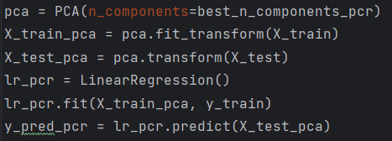
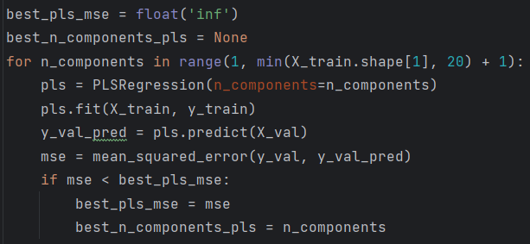
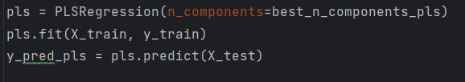
Python Explanation-Principal Component Regression (PCR)/Partial Least Squares Regression (PLS)
• Train PCR with best hyperparameter
• Hyperparameter tuning and Partial Least Squares Regression
• Train PLS with best hyperparameter
Create a PCA object with the best number of components
Reapply PCA to the training data
Transform the test data using the fitted PCA
Initialize a new linear regression model
Fit the linear regression model on the PCA-transformed training data
Predict the returns for the test set
Initialize the best PLS MSE as infinity
Initialize the best number of PLS components as None
Loop over number of components from 1 to min(number of features, 20)
Create a PLSRegression object with the given number of components
Fit the PLS model using the training data
Predict the returns for the validation set
Calculate the mean squared error (MSE) on the validation set
If the current MSE is lower than the best recorded MSE
Update the best MSE
Update the best number of components
Create a PLSRegression object with the best number of components Fit the PLS model using the training data
Predict the returns for the test set and flatten the output

Slide 33

Principal Component Regression (PCR) Results for Stock Return Prediction: A Time Series Analysis of the generated Sample Data

Slide 34

Partial Least Squares Regression (PLS) Results for Stock Return Prediction: A Time Series Analysis of the generated Sample Data

Slide 35
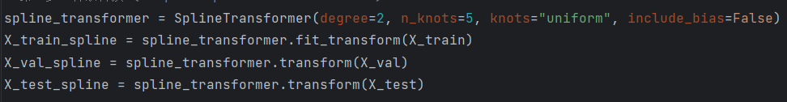


g∗(zi,t​)
g(zi,t​;θ)
Generalized Linear Regression
Steps:
Step 1: Model Setup and Predictor Expansion
g(z;θ,p(⋅)): The conditional expected return as modeled by the generalized linear regression.
p(zj): The basis function vector, representing a nonlinear transformation of the original predictor zj
θj: The regression coefficients associated with the j-th predictor's basis functions.
P: The number of original stock characteristics (predictors). Examples of such characteristics include market capitalization, book-to-market ratio, momentum, and volatility.
A second-order spline expansion is adopted as the basis function:
where c1,c2,...,cK−2 are knots of the spline functions.
Standard linear regression assumes a direct linear relationship:
Generalized Linear Model (GLM) with spline expansion first transforms zj​ using nonlinear basis functions, then applies regression:
The Generalized Linear Model (GLM) extends the classical linear regression model by introducing nonlinear transformations while maintaining interpretability. Spline expansion enables the prediction function g(z;θ,p(⋅)) to better capture nonlinear relationships while avoiding the complexity and lack of interpretability inherent in deep neural networks. Second-order splines allow for smooth data fitting while avoiding excessive oscillations.

Slide 36

g∗(zi,t​)
g(zi,t​;θ)
Generalized Linear Regression
Steps:
Step 2: Make Predictions Using the Dimension-Reduced Model
ϕ(θ;λ,K): The group lasso penalty function.
λ: The penalization strength, controlling the sparsity of the selected features.
K: The number of basis functions per predictor.
θj,k: The k-th coefficient for the j-th predictor's basis functions.
Define the penalty function to apply group-wise shrinkage to the coefficients θj,k of all basis functions for each predictor zj. Ensure that entire groups (all basis functions for a predictor) are either selected or excluded, promoting sparsity at the predictor level.
To regularize the model by reducing overfitting, especially in the high-dimensional setting where predictors are expanded into many basis functions.

Slide 37


g∗(zi,t​)
g(zi,t​;θ)
Generalized Linear Regression
Steps:
Step 3: Optimization of the Penalized Loss Function
The combined full objective function in a single line is:
Minimize the objective function L(θ;λ,K) with respect to θ using optimization algorithms such as accelerated proximal gradient descent. Tune the hyperparameters λ (penalization strength) and K (number of basis functions) using validation data.
To estimate the model coefficients θ while balancing fit quality and complexity through penalization.
Step 4: Out-of-Sample Prediction
Use the optimized model to predict future returns:
θ^: The estimated coefficients after optimization.
g(zi,t;θ^,p(⋅)): The predicted return based on the fitted model.
Apply the basis function transformations p(zj) to new predictors zi,t. Use the fitted coefficients θ^ to compute predictions r^i,t+1.
To produce predictions for asset returns based on the trained and regularized model.

Slide 38
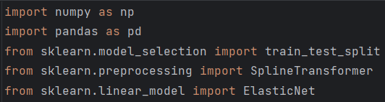
Python Explanation-Generalized Linear Regression
• Import library
• The sample data construction part is the same as the OLS part
• Spline transformation
Import NumPy library for array and mathematical operations
Import Pandas library for data manipulation and analysis
Import train_test_split from scikit-learn for dataset splitting
Import SplineTransformer for spline basis transformations
Import ElasticNet for Elastic Net regression
Create spline transformer with quadratic splines and 5 uniformly distributed knots
Apply spline transformation to training data
Apply spline transformation to validation data
Apply spline transformation to testing data

Slide 39
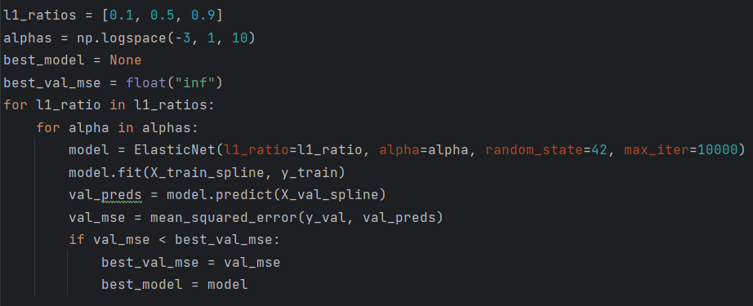
Python Explanation-Generalized Linear Regression
• hyperparameter tuning
• Predict on the test set
• Split data into training and testing sets
• Spline transformation
Define list of l1_ratio values
Define list of alpha values logarithmically spaced
Initialize best_model as None
Initialize best validation MSE as infinity
Loop over each l1_ratio value
Loop over each alpha value
Initialize ElasticNet model with current hyperparameters
Fit the model on the training data
Predict on the validation set
Compute mean squared error for validation set
If current model performs better, update best model
Update best validation MSE
Set current model as best model
Predict on the test set using the best model

Slide 40
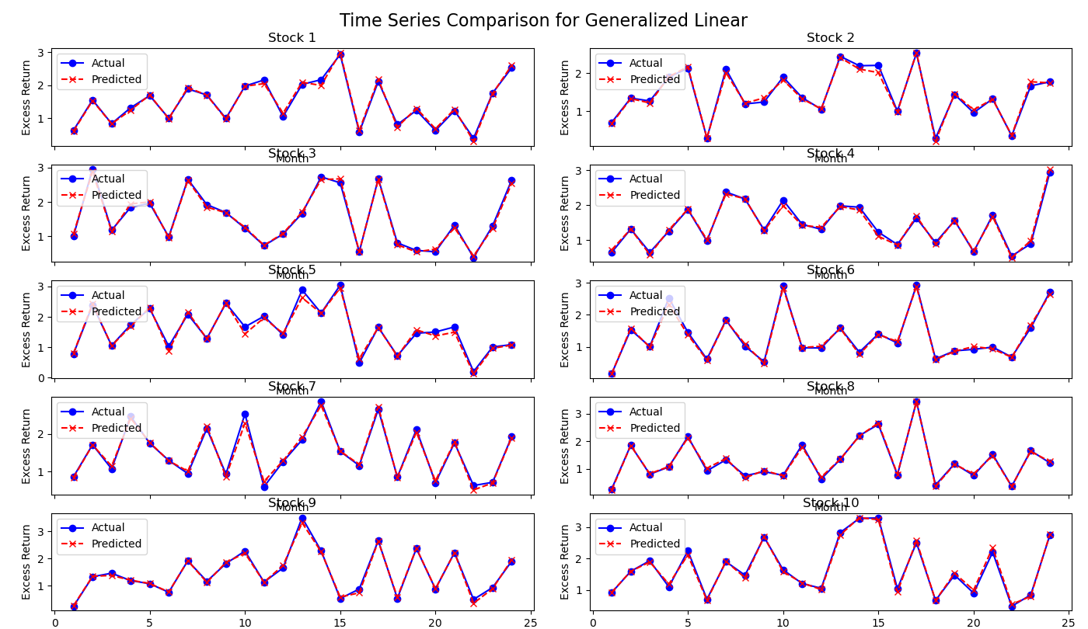
Generalized Linear Regression Results for Stock Return Prediction: A Time Series Analysis of the generated Sample Data

Slide 41
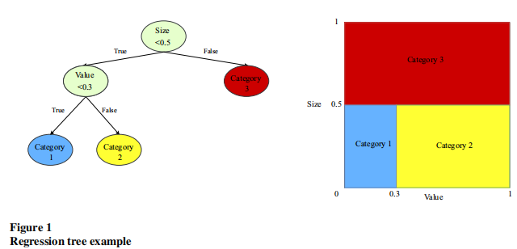

Boosted regression trees and random forests
g∗(zi,t​)
g(zi,t​;θ)
Steps:
Step 1: Building a single regression tree model
g(zi,t​;θ,K,L):Prediction function of the regression tree for asset i at time t.
zi,t:Predictor vector for asset i at time t.
K:Number of leaves (terminal nodes) in the regression tree.
L:Maximum depth of the regression tree.
θk​:Mean of the target variable (ri,t+1​) within partition Ck(L).
Ck(L):Partition of the predictor space corresponding to the k-th leaf node.
1{zi,t∈Ck(L)}:Indicator function; equals 1 if zi,t​ belongs to partition Ck(L), 0 otherwise.
The example in Figure 1 has the following prediction equation:
To partition the predictor space into K disjoint regions and assign each region a mean value θk as the prediction.
Figure 1 shows an example with two predictors, “size” and “b/m.” The left panel describes how the tree assigns each observation to a partition based on its predictor values. First, observations are sorted on size. Those above the breakpoint of 0.5 are assigned to Category 3. Those with small size are then further sorted by b/m. Observations with small size and b/m below 0.3 are assigned to Category 1, while those with b/m above 0.3 go into Category 2. Finally, forecasts for observations in each partition are defined as the simple average of the outcome variable’s value among observations in that partition.

Slide 42

Boosted regression trees and random forests
g∗(zi,t​)
g(zi,t​;θ)
Steps:
Step 2: Build the Tree Structure
H(θ,C): Impurity (or loss) of a partition C.
|C|: Number of observations in partition C.
ri,t+1: Observed outcome for asset i at time t+1 (e.g., realized excess return).
θ: Mean value of ri,t+1 in partition C.
For a candidate split, calculate Hsplit=H(θ,C1)+H(θ,C2), where C1 and C2 are the resulting partitions.
Choose the split that minimizes Hsplit.
Continue splitting recursively until a pre-specified depth L is reached or other stopping criteria are met (e.g., minimum number of observations per leaf). It ensures each split improves the homogeneity within partitions, minimizing prediction error.

Slide 43





Boosted regression trees and random forests
g∗(zi,t​)
g(zi,t​;θ)
Steps:
Step 3: Combine Trees for Ensemble Methods
Boosted Regression Trees (BRT):
Random Forests (RF):
1.Stepwise Fitting:
Fit a shallow tree gb(zi,t) to the residuals from the previous tree:
1.Bootstrap Sampling:
Generate B bootstrap samples from the training data.
2.Tree Construction:
For each sample, grow a tree Tb(zi,t) using a random subset of predictors at each split. Each tree uses formula for predictions:
2.Additive Model:
Combine predictions from all trees:
3.Aggregate Predictions:
Average predictions across all B trees:
where ν is a shrinkage parameter controlling the contribution of each tree.

Slide 44

Boosted regression trees and random forests
g∗(zi,t​)
g(zi,t​;θ)
Steps:
Step 4: Final Prediction
For both BRT and RF, the final prediction for asset i at time t is:
where g^(zi,t) is the combined output from all trees.

Slide 45
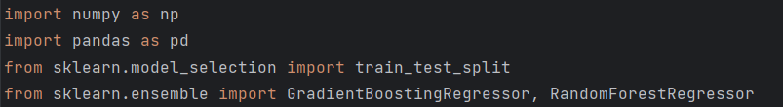
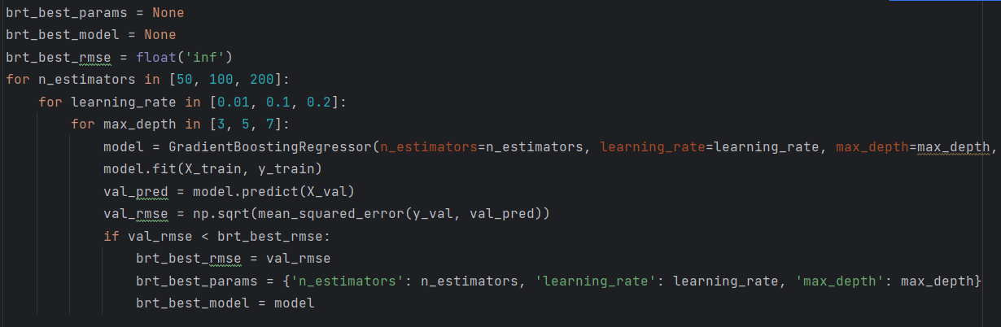
Python Explanation-Boosted regression trees and random forests
• Import library
• The sample data construction part is the same as the OLS part.
• Hyperparameter Optimization for Boosted Regression Trees (BRT)
• Predict for BRT on test set
Import NumPy for numerical computations
Import Pandas for data processing
Import tool for splitting train and test sets
Import GradientBoostingRegressor and RandomForestRegressor
Initialize best parameters storage
Initialize best model storage
Set initial RMSE to infinity
Loop through different numbers of decision trees
Loop through different learning rates
Loop through different maximum tree depths
Create BRT model with the current hyperparameter combinationTrain the BRT model on the training set
Predict on validation set
Calculate RMSE on the validation set
Update best parameters if current RMSE is lower than previous best RMSE
Update best RMSE
Update best hyperparameters
Update best model
Predict on the test set using the best model

Slide 46
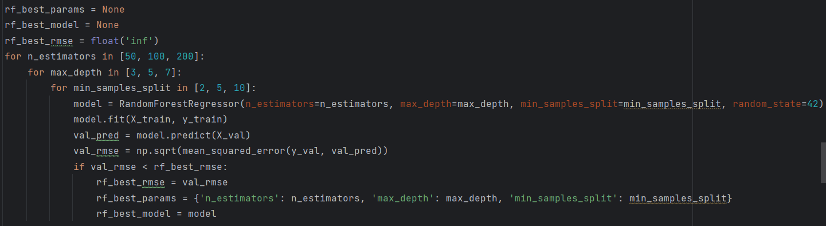
Python Explanation-Boosted regression trees and random forests
• Hyperparameter Optimization for Random Forests (RF)
• Predict for RF on test set
Initialize best parameters storage
Initialize best model storage
Set initial RMSE to infinity
Loop through different hyperparameter combinations to select the best ones
Loop through different numbers of decision trees
Loop through different maximum tree depths
Loop through different minimum samples required for a split
Create RandomForest model with the current hyperparameter combination
Train the RandomForest model on the training set
Predict on validation set
Calculate RMSE on the validation set
Update best parameters if current RMSE is lower than previous best RMSE
Update best RMSE
Update best hyperparameters
Update best model
Predict on the test set using the best model

Slide 47
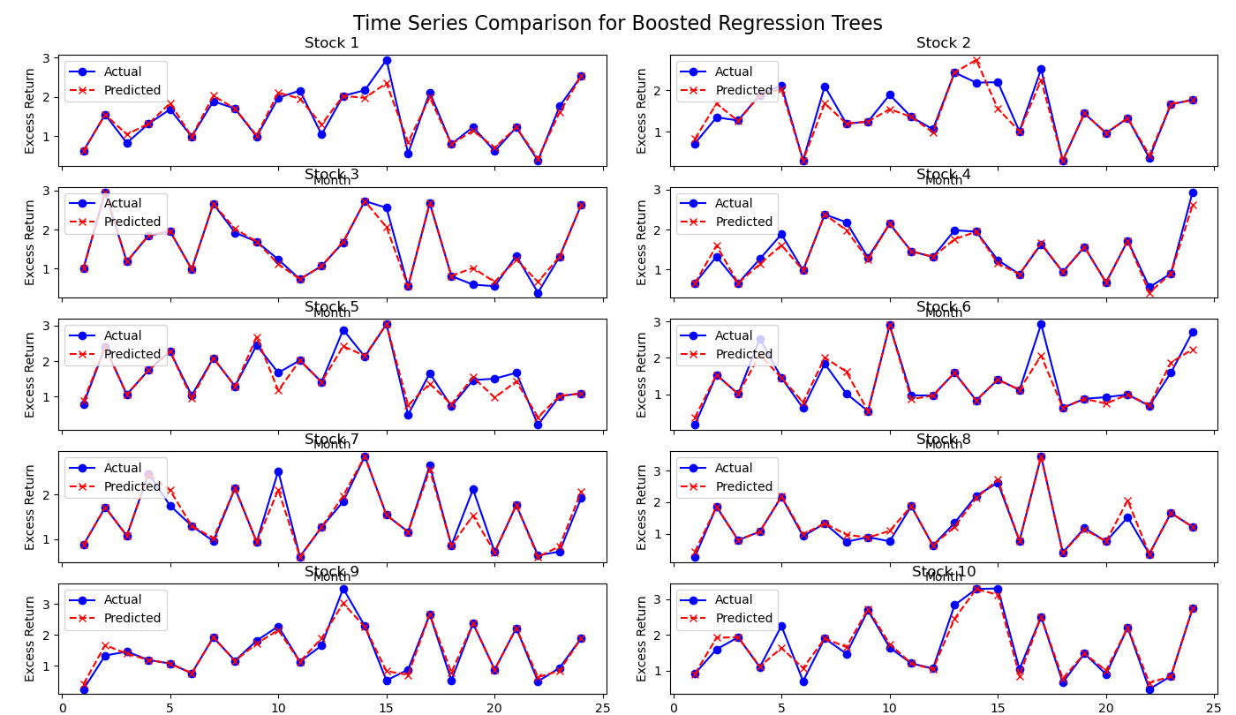
Boosted regression trees Results for Stock Return Prediction: A Time Series Analysis of the generated Sample Data

Slide 48
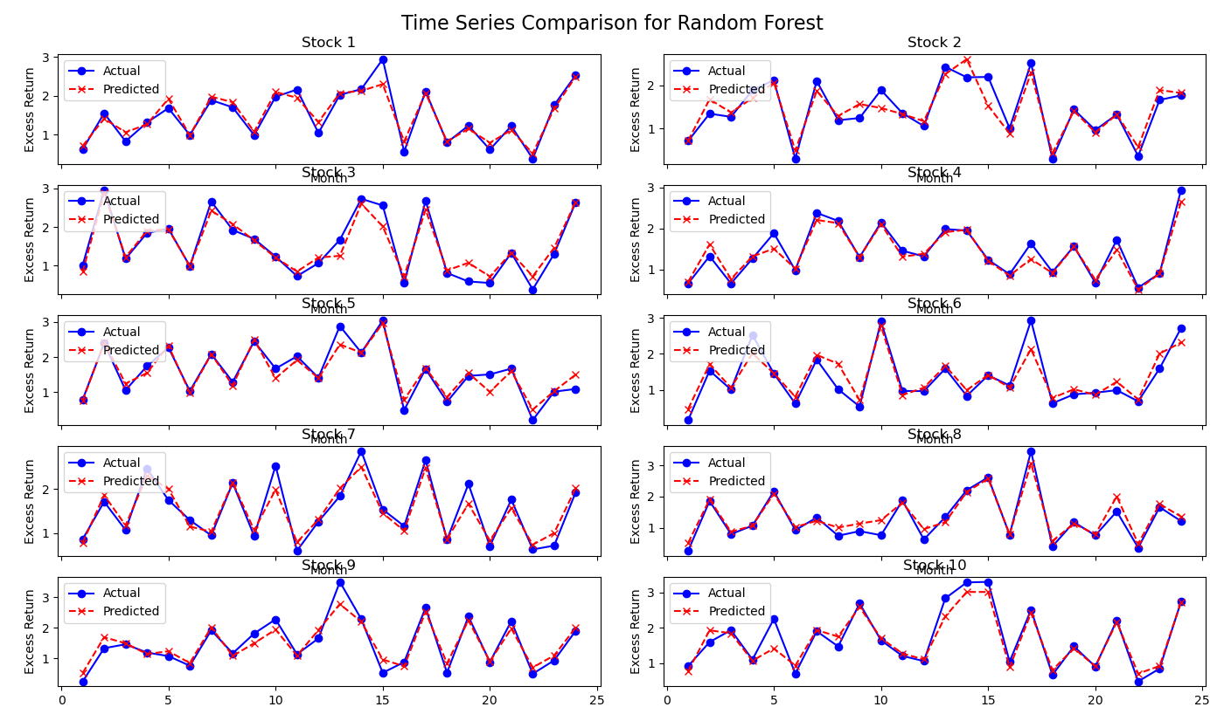
Random Forests Results for Stock Return Prediction: A Time Series Analysis of the generated Sample Data

Slide 49


g∗(zi,t​)
g(zi,t​;θ)
Neural Network
Steps:
Step 1: Initialization
Define the input layer:
Input
represents raw predictor variables.
Include a bias term by augmenting the input vector:
Choose network architecture:
Specify the number of hidden layers L, neurons per layer K^{(l)}, and activation functions.

Slide 50
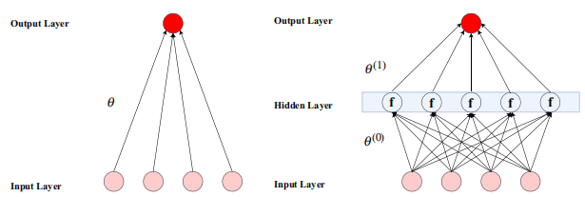


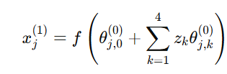


g∗(zi,t​)
g(zi,t​;θ)
Neural Network
Steps:
Step 2: Forward Propagation
Layer-wise transformations:
Compute the outputs for each hidden layer using formula :
z: Input vector of raw predictors.
x_{k}^{(l)}: Output of neuron k in layer l.
θ_{k}^{(l)}: Weight parameters associated with the connections to neuron k in layer l.
ReLU(⋅): Rectified Linear Unit activation function, defined as:
Inputs (z1,z2,z3,z4) are fed into the input layer.
Linear Aggregation: Each neuron computes a weighted sum of inputs:
Defines the output of neuron k in layer l. This captures the nonlinear transformation of the input signal by applying a weight matrix θ_{k}^{(l−1)} and an activation function (ReLU).
Final Output Layer Transformation:
Nonlinear Transformation: The activation function f (ReLU)
introduces nonlinearity.
Compute the prediction using formula below:
L: Total number of layers in the neural network.
g(z; θ): Final output, representing the predicted return.
θ: Combined parameter set for all layers in the network.
The final layer aggregates the outputs from the hidden layer neurons:
Aggregates all transformed signals from the last hidden layer into a single prediction output.

Slide 51




g∗(zi,t​)
g(zi,t​;θ)
Neural Network
Steps:
Step 3: Backpropagation for Optimization
1.Objective Function:
Minimize the penalized L2 objective:
Regularization: penalizes large weight magnitudes to prevent overfitting.
2.Gradient Descent Optimization:
Use Stochastic Gradient Descent (SGD) to update weights:
η is the learning rate
3.Regularization Techniques:
Employ early stopping, batch normalization, and dropout to prevent overfitting.
Step 4: Prediction
After training, use the optimized parameters θ^ for prediction:

Slide 52
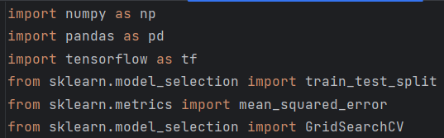
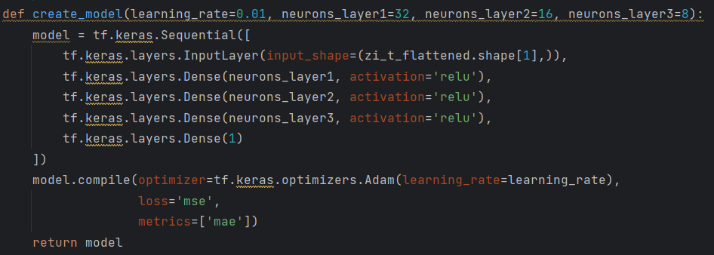
Python Explanation-Neural Network
• Import library
• The sample data construction part is the same as the OLS part.
• Neural Network Model
Import numpy library for data generation and processing
Import pandas library for data manipulation and analysis
Import TensorFlow library for building and training neural networks
Import train_test_split from sklearn for splitting train and test datasets
Import mean_squared_error from sklearn to calculate mean squared error
For hyperparameter optimization
Create a neural network model：(Learning rate controls optimizer step size；neurons_layer: Number of neurons in the first/second/ hidden/third layer)
Use Sequential model
Input layer with shape equal to number of zi_t features
Hidden layer 1
Hidden layer 2
Hidden layer 3
Output layer
Adam optimizer
Loss function is mean squared error
Mean absolute error

Slide 53
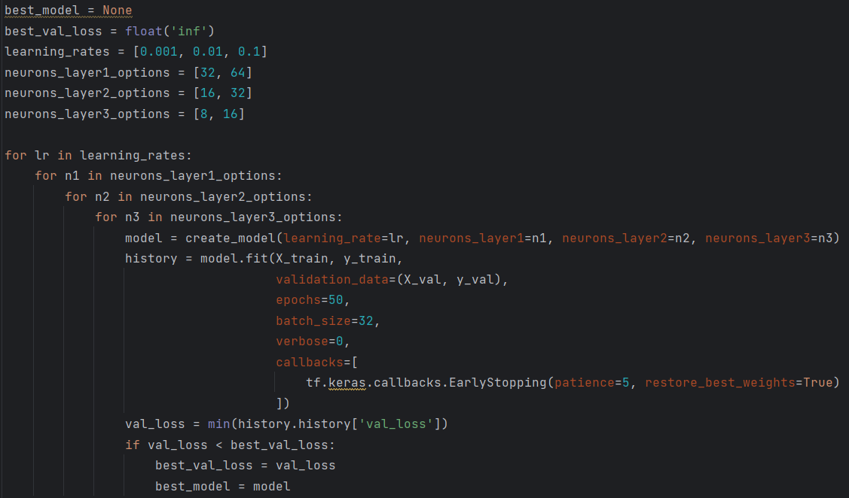
Python Explanation-Neural Network
• Hyperparameter Optimization
• Evaluate the Best Model on Test Set
Initialize the best model variable, initially no model is selected
Initialize the minimum validation loss to infinity to find a better model
Set the list of learning rates to try
Options for the number of neurons in the first hidden layer
Options for the number of neurons in the second hidden layer
Options for the number of neurons in the third hidden layer
Iterate over all learning rates
Iterate over options for the number of neurons in the first hidden layer
Iterate over options for the number of neurons in the second hidden layer
Iterate over options for the number of neurons in the third hidden layer
Create a neural network model with the current hyperparameter combination
Train the model and evaluate on the validation set
Evaluate model performance on validation set
Train the model for 50 epochs
Each training batch contains 32 samples
Suppress detailed logs
Callbacks including early stopping
Stop training if no improvement for 5 iterations, restore best weights
Get the minimum validation loss for the current hyperparameter combination
If the current model has a lower validation loss, update the best model
Update the current best validation loss value
Update the current best model
Predict on test set

Slide 54
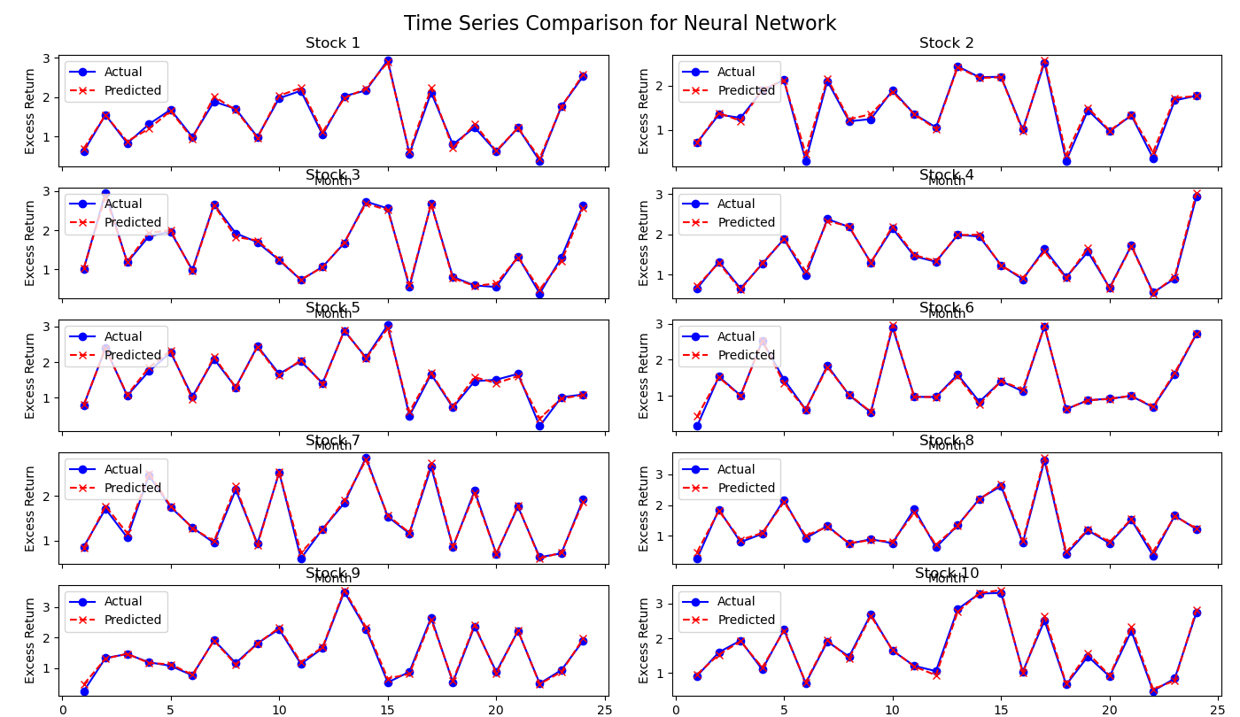
Neural Network Results for Stock Return Prediction: A Time Series Analysis of the generated Sample Data

Slide 55
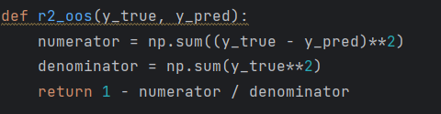

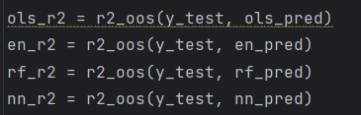
Assessing predictive power
The standard out-of-sample R² statistic:
R_{oos}^{2​}: Out-of-sample R², which measures the predictive performance of the model.
ri,t+1: The actual excess return of stock i at time t+1.
r^i,t+1: The predicted excess return of stock i at time t+1.
T3: The test sample set, comprising observations not used for training or validation.
This formula is used to measure the out-of-sample predictive performance of a model, aiming to evaluate how closely the predicted values r^i,t+1 match the actual values ri,t+1. This formula provides a consistent and comparable metric for assessing model performance.
Numerator: Represents the sum of squared prediction errors, which quantifies the total deviation of predictions r^i,t+1 from actual outcomes ri,t+1. A smaller numerator indicates higher predictive accuracy.
Denominator: Represents the sum of squared actual excess returns without demeaning. This serves as a benchmark and ensures the evaluation is based on the magnitude of the actual data rather than relative to a sample mean. Using undemeaned returns avoids inflating the R_{oos}² by comparing against a noisy mean prediction.
By calculating R_{oos}² on the test dataset, researchers can:
Determine whether the model improves prediction accuracy (R_{oos}²>0 indicates better-than-naive predictions).
Compare the predictive performance of different models (higher R_{oos}² indicates better performance).

Slide 56
The computed results of the standard out-of-sample R² statistic in the generated sample data
Model | OLS | Weighted Linear Regression | Huber | ElasticNet | PCR | PLS | Generalized Linear | Neural Network | Boosted Regression Trees | Random Forest
Out-of-Sample R² | 0.996831186 | 0.996723293 | 0.996604838 | 0.990315146 | 0.996831186 | 0.996875776 | 0.990549716 | 0.991076154 | 0.903032359 | 0.881419004

Slide 57
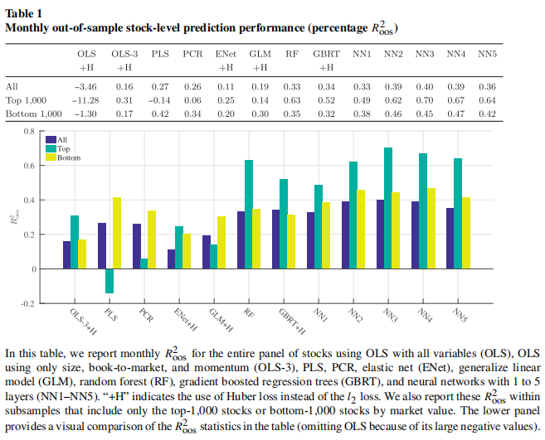
The computed results of the standard out-of-sample R² statistic in the paper
Baseline Models:
OLS with All Covariates:Predictive R²=−3.46% for the entire pooled sample.This poor performance reflects severe overfitting due to the high dimensionality of predictors (920 features) and lack of regularization.
OLS-3 (Size, Book-to-Market, Momentum):Predictive R²=0.16% demonstrating substantial improvement by using only three robust predictors.
These results confirm that naive OLS fails in high-dimensional settings but performs modestly well with limited predictors.
Regularized Linear Models:
Elastic Net (ENet):R²=0.11%. By penalizing coefficients, ENet mitigates overfitting, providing better predictions than full OLS but still limited due to its linear nature.
Partial Least Squares (PLS) and Principal Components Regression (PCR):R²=0.27% and R²=0.26%, respectively.These dimension-reduction techniques outperform penalized regression by condensing noisy predictors into a few informative components.
Nonlinear Models:
Random Forest (RF) and Gradient Boosted Regression Trees (GBRT): R²=0.33% and R²=0.34%, respectively. These models leverage nonlinearities and interactions among predictors, yielding better predictive performance.
Neural Networks (NN1-NN5): Performance improves with increasing network complexity, peaking at R²=0.40% for NN3 (three hidden layers).Models with four or five layers show diminishing returns, likely due to the low signal-to-noise ratio in stock returns data.
Subsample Results:
Predictions are broken down by large-cap (top-1,000 stocks) and small-cap (bottom-1,000 stocks) subsamples.
Nonlinear models (trees and neural networks) achieve the best performance in both cases, with higher R² values for large-cap stocks (up to 0.70% for NN3).
This result supports the hypothesis that machine learning models excel in predicting returns for larger, more liquid stocks.

Slide 58
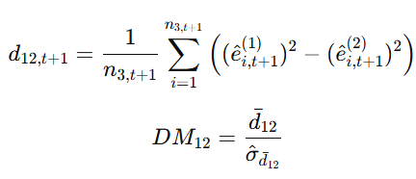






Forecast comparison
The DM test-statistic for a comparison between methods 1 and 2：compare the relative performance of two forecasting methods.
d12,t+1​: The mean squared error difference between models (1) and (2) at time t+1.If (e^i,t+1(1))2 >(e^ , then d12,t+1>0, indicating that model (2) has smaller prediction errors.
e^i, and e^i, : Prediction errors for stock i at time t+1 from models (1) and (2), respectively.
n3,t+1: Number of stocks in the test sample at time t+1.
d : The average value of d12,t over the test sample.
σ : The standard error of dˉ1.
Numerator: Represents the squared error difference between models (1) and (2) for each stock. Positive values indicate that model (2) has smaller squared errors (better predictions), while negative values indicate the opposite.
Denominator: Standardizes the average difference dˉ by dividing it by its standard error σ^d. This ensures the test statistic accounts for variability in the differences, enabling statistical inference.
A positive DM₁₂ value signifies that model (2) has better predictive performance than model (1), as its squared errors are smaller, leading to more accurate predictions.

Slide 59
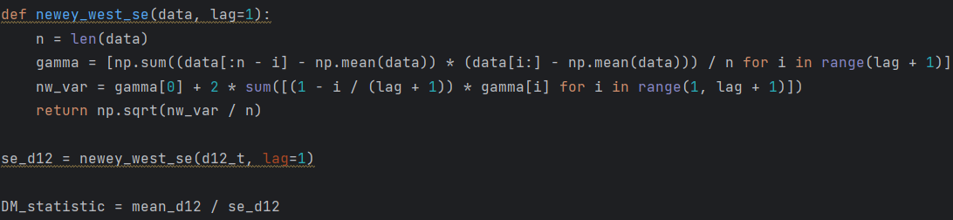
Forecast comparison
The DM test-statistic for a comparison between methods 1 and 2：compare the relative performance of two forecasting methods.

Slide 60
The calculation results of the Diebold and Mariano test statistic in the generated sample data
method（2）
 | OLS | Weighted | Huber | ElasticNet | PCR | PLS | Generalized | Neural Network | BRT | Random Forest
OLS |  | -0.54085295 | -2.086580596 | -5.532906746 | 1.322758091 | 1.574642625 | -3.196485091 | -2.895241947 | -5.196619996 | -5.732472541
Weighted |  |  | -0.48830909 | -4.913319211 | 0.54085295 | 0.79125998 | -3.161332021 | -2.752622484 | -5.187252318 | -5.726493746
Huber |  |  |  | -5.371775862 | 2.086580596 | 2.248249511 | -3.08342493 | -2.765289568 | -5.188074231 | -5.722216928
ElasticNet |  |  |  |  | 5.532906746 | 5.567525864 | 0.09793614 | 0.388141787 | -4.832079828 | -5.451314444
PCR |  |  |  |  |  | 1.574642625 | -3.196485091 | -2.895241947 | -5.196619996 | -5.732472541
PLS |  |  |  |  |  |  | -3.224796458 | -2.914872907 | -5.197735399 | -5.73406659
Generalized |  |  |  |  |  |  |  | 0.171640694 | -4.971751321 | -5.617863649
Neural Network |  |  |  |  |  |  |  |  | -4.745676961 | -5.350161407
BRT |  |  |  |  |  |  |  |  |  | -2.043746183
Random Forest
method（1）
Positive values indicate the column model outperforms the row model.

Slide 61
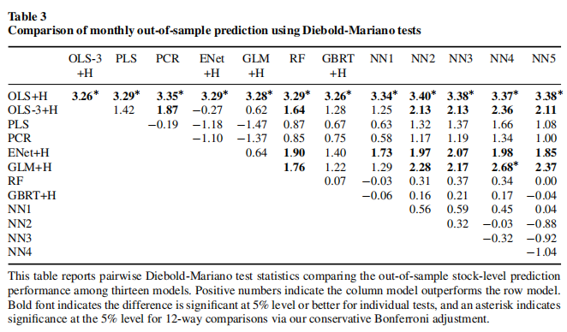

The calculation results of the Diebold and Mariano test statistic in the paper
Linear vs. Constrained Linear Models:Unconstrained OLS significantly underperforms compared to constrained linear models such as OLS-3, PLS, PCR, and Elastic Net (ENet). The addition of regularization or dimension reduction leads to substantial predictive improvements over the naïve OLS model.
Comparison Among Linear Models:Differences between penalized linear methods (ENet) and dimension reduction techniques (PLS and PCR) are minimal, with no clear dominance of one approach over the other. This suggests that both strategies effectively mitigate overfitting and capture predictive signals.
Nonlinear Methods vs. Linear Methods: Tree-based models, such as Random Forest (RF) and Gradient Boosted Regression Trees (GBRT), generally outperform linear models. However, the statistical significance of these improvements is marginal.Neural networks (NNs) consistently and significantly outperform linear and generalized linear models, showcasing the value of allowing for complex interactions and nonlinear relationships.
Neural Networks vs. Tree-Based Models: Neural networks improve upon tree-based methods, though the differences are not statistically significant at the 5% level. This highlights the nuanced trade-offs between model flexibility and overfitting.
Table 3 evaluates the statistical significance of performance differences between machine learning models using Diebold-Mariano (DM) test statistics. The table facilitates a pairwise comparison of predictive accuracy, where:
Positive values indicate the column model outperforms the row model.
Statistically significant differences are highlighted in bold (at the 5% level) and with an asterisk for comparisons passing the Bonferroni correction.

Slide 62
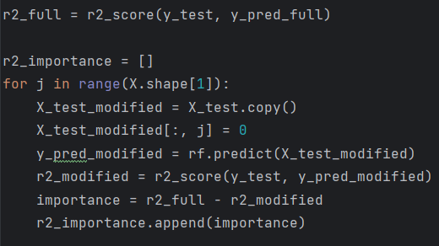



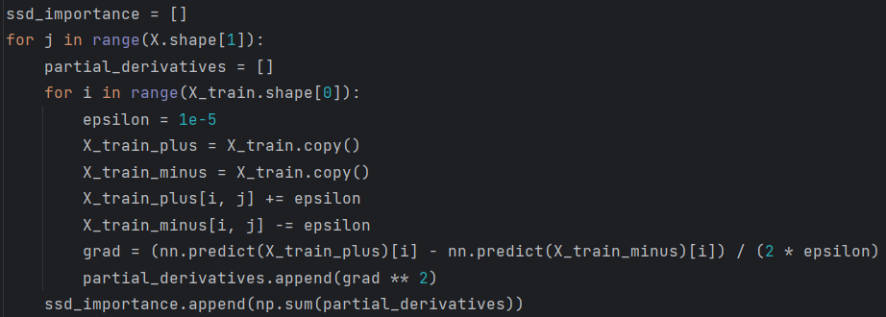

Variable Importance and Marginal Relationships
Variable Importance :
Sum of Squared Derivatives (SSD) :
Rmo : The out-of-sample predictive R² of the full model using all predictors.
R−j: The out-of-sample predictive R² of the model after setting the j-th variable to zero.
Procedure:
1.Iteratively set each variable j to zero.
2.Recalculate the model’s predictive R².
3.Compare the difference between the full model R² and the R² after setting z_{j}=0.
Measures the contribution of variable j to the model's predictive performance. Directly reflects the incremental impact of variable j on R².
g(z;θ): The model’s function for forecasting.
zj: The j-th input variable.
T1: The training dataset.
Procedure:
1.Compute the partial derivative of the model output with respect to each predictor zj.
2.Square the derivatives and sum them across all training samples.
Quantifies the model’s sensitivity to changes in variable j.Reflects the marginal impact of zj on the model's predictions.

Slide 63
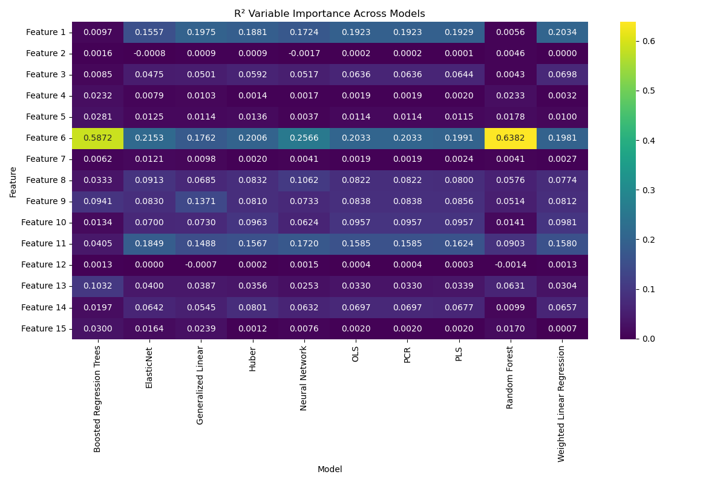
The Results of the Variable Importance in the generated sample data

Slide 64
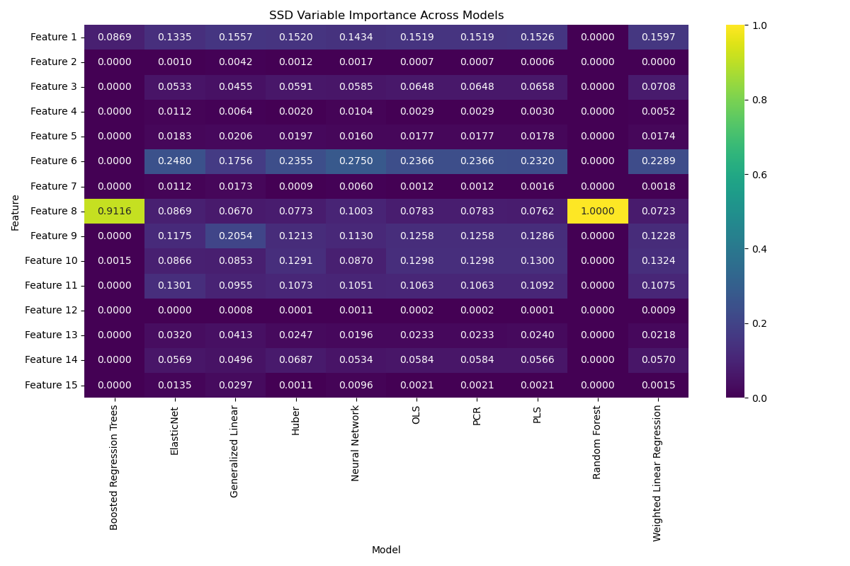
The Results of SSD in the generated sample data

Slide 65
The Results of the Variable Importance in the paper
Dominant Predictive Variables: The most important predictors across models can be categorized into four main groups:
Momentum and Reversal Variables:
Short-term reversal (mom1m), stock momentum (mom12m), industry momentum (indmom), momentum change (chmom), long-term reversal (mom36m), and maximum return (maxret).
Liquidity Variables:
Turnover (turn), turnover volatility (std_turnstd), log market equity (mvel1), dollar volume (dolvol), Amihud illiquidity (ill), bid-ask spread (baspread), and the number of zero trading days (zerotrade).
Risk Measures:
Total return volatility (retvol), idiosyncratic volatility (idiovol), market beta (beta), and beta squared (betasq).
Valuation and Fundamental Signals:
Earnings-to-price ratio (ep), sales-to-price ratio (sp), asset growth (agr), and the number of recent earnings increases (nincr).

Slide 66
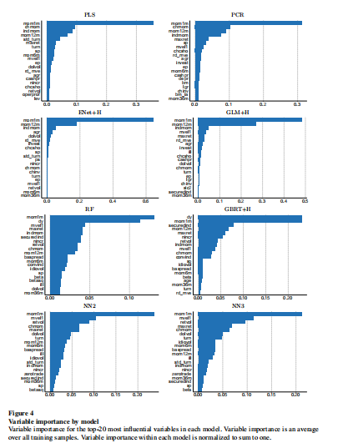
The Results of the Variable Importance in the paper
Differences Across Models:
Penalized Linear and Dimension Reduction Models: These models exhibit strong reliance on momentum and reversal predictors, with a clear skew toward a small subset of variables.
Tree-Based Models and Neural Networks: These models draw predictive power more evenly across a broader range of variables. Their flexibility allows them to account for complex interactions and nonlinear relationships among predictors.
Momentum and Liquidity as Dominant Predictors:
Momentum and reversal variables are consistently the most significant predictors, reinforcing their importance in empirical asset pricing. This aligns with existing literature that emphasizes their predictive power for stock returns.
Model-Specific Patterns:
Penalized linear models and dimension reduction methods focus on a narrower subset of predictors, which may limit their ability to capture broader relationships.
Tree-based methods and neural networks utilize a wider array of predictors, suggesting their superior ability to account for nonlinearities and interactions.
Conclusion: Figure 4 demonstrates that machine learning models, despite methodological differences, converge on a core set of influential predictors dominated by momentum, liquidity, and volatility variables. These findings underscore the robustness of these characteristics in explaining stock returns. Additionally, tree-based methods and neural networks leverage a wider range of features, highlighting their flexibility and suitability for capturing complex relationships in financial data.

Slide 67
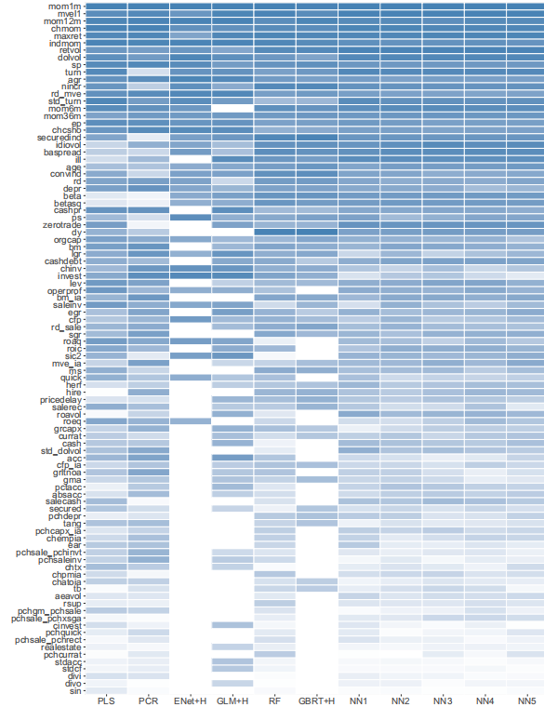
The Results of the Variable Importance in the paper
The figure presents the overall importance rankings of 94 stock-level characteristics and one industry dummy variable (sic2). The importance of each characteristic is ranked based on its contribution to each model, and the ranks are summed across all models to determine the final ordering. Characteristics are arranged from the most important (top) to the least important (bottom), with color gradients within each column indicating model-specific rankings, where dark blue represents the most important variables and white the least important.
Machine learning models exhibit high consistency in ranking key predictors, particularly momentum, liquidity, and volatility variables, highlighting their robustness in stock return prediction.
Penalized linear models (e.g., ENet, GLM) and dimension reduction methods (e.g., PLS, PCR) rely heavily on momentum and reversal variables.
Tree-based models (e.g., RF, GBRT) and neural networks (e.g., NN3) draw predictive information from a broader set of characteristics, with a more evenly distributed importance. Tree-based models and neural networks excel in capturing complex interactions and nonlinear relationships between predictors, outperforming penalized linear and dimension reduction methods in terms of variable utilization.

Slide 68

The Results of the Sum of Squared Derivatives (SSD) in the paper
Figure A.2 showcases the results of variable importance calculated using the SSD (Sum of Squared Derivatives) method proposed by Dimopoulos, Bourret, and Lek (1995). This method evaluates the sensitivity of the model predictions to changes in individual input variables. The SSD measure highlights the most influential variables contributing to the accuracy of predictions across different models.
The SSD-based rankings align closely with the rankings derived from the simpler R²-based importance measure.
Momentum and liquidity-related variables, such as short-term reversal (mom1m), stock momentum (mom12m), and turnover (turn), consistently rank as the most influential across models.
Risk measures (e.g., volatility, beta) and valuation/fundamental signals (e.g., earnings-to-price, asset growth) also exhibit significant influence but to a lesser extent than momentum and liquidity variables.
Momentum and Liquidity Dominate:Momentum-related variables consistently emerge as the most significant predictors across different models, underscoring their central role in asset pricing.
Model Flexibility and SSD:SSD serves as a robust and interpretable metric for understanding variable importance, particularly in flexible models like neural networks and generalized linear models.
Practical Usefulness:The high correlation between SSD and R² importance rankings validates SSD as a reliable method for identifying influential predictors, even in the presence of high-dimensional data.

Slide 69



Performance of the machine learning portfolios
Trading on Machine Learning Predictions:
1.Pred (Predicted Return): The predicted monthly return generated by the machine learning model based on input features.
2.Avg (Average Realized Return): The average realized monthly return for each portfolio.
3.SD (Standard Deviation): The standard deviation of monthly returns, representing the portfolio's volatility (risk).
g(zi,t​): The machine learning model's prediction function.
zi,t​: A vector of stock-specific features and macroeconomic variables.
Represents the model's expected return for each portfolio. Used to evaluate the model’s predictive accuracy by comparing it with actual realized returns (Avg).
rd,t+1​: The realized monthly return for portfolio d at time t+1.
T: The total number of months in the evaluation period.
Reflects the actual performance of each portfolio.Serves as a benchmark to validate the model's predictive accuracy.
Measures the portfolio's risk level, with higher values indicating greater volatility.

Slide 70


Performance of the machine learning portfolios
Trading on Machine Learning Predictions:
4.SR (Sharpe Ratio): The Sharpe ratio, a measure of risk-adjusted return.
Steps:
rf​: The risk-free rate.
Assesses the trade-off between return and risk for each portfolio. A higher Sharpe ratio indicates better risk-adjusted performance.
Step 1: Predict Stock Returns:
Generate Predictions: Predict the next period’s returns for each stock using machine learning models
r^i,t+1​: Predicted return for stock i at time t+1.
zi,t: A vector of stock-specific features and macroeconomic variables.
Generate stock-level return predictions to serve as the foundation for portfolio construction.
Step 2: Construct Ranked Portfolios:
2.1.Sort Stocks into Deciles: Sort stocks by their predicted returns r^i,t+1 and divide them into 10 equal-weighted deciles (from low to high). Portfolios are value-weighted, with weights determined by market capitalization.
Purpose: Construct portfolios ranked by predicted returns, ranging from low to high expected returns.
2.2.Calculate Actual Returns for Each Decile:Compute the realized return of each decile d:
wi,t​: Value weight of stock i in decile d.
ri,t+1: Realized return of stock i at time t+1.

Slide 71



Performance of the machine learning portfolios
Steps:
2.3.Construct Long-Short Portfolio:
Compute the return for a long-short portfolio (10-1 strategy) by buying the highest decile (10) and selling the lowest decile (1):
Evaluate the effectiveness of model predictions in identifying high- and low-performing stocks.
Step 3: Calculate Portfolio Performance Metrics
3.1 Annualized Return: Calculate the average monthly return rˉd​ for each decile and annualize it
3.2 Annualized Volatility: Compute the standard deviation of monthly returns σd for each decile and annualize it
3.3Sharpe Ratio (SR): Calculate the Sharpe ratio for each decile and the long-short portfolio
rf​ is the risk-free rate.
Assess the risk-adjusted return of each portfolio.
Step 4: Evaluate and Compare Model Performance
Model Comparison: Compare average returns, volatility, and Sharpe ratios across different machine learning models for high and low deciles, as well as the long-short portfolio.
Robustness Checks: Analyze the consistency between predicted returns and actual returns across deciles.

Slide 72

Performance of the machine learning portfolios
Results:
1.Monotonicity in Returns:
Portfolio returns increase monotonically from the lowest to the highest decile for all models, demonstrating the models' ability to effectively rank stocks by expected returns.
2.Superiority of Nonlinear Models:
Neural networks (NN3, NN4) and tree-based models (GBRT) perform best in long-short strategies, with significantly higher Sharpe ratios compared to linear models.
NN4 achieves the highest Sharpe ratio for the long-short portfolio, at 1.35.
3.Return-Risk Balance:
Nonlinear models achieve higher annualized returns while maintaining moderate levels of volatility, resulting in superior risk-adjusted performance.
4.Disparities Across Deciles:
The returns and Sharpe ratios for the highest decile (10) are significantly greater than those for the lowest decile (1), indicating the effectiveness of machine learning models in capturing return heterogeneity.
Table 7 highlights the strong capabilities of machine learning models in asset pricing and portfolio construction. Nonlinear methods, such as neural networks and gradient-boosted regression trees, excel at capturing complex relationships and provide superior return predictions and portfolio performance. These results demonstrate the potential of machine learning to revolutionize portfolio management by offering unparalleled accuracy and insights in high-dimensional financial datasets.

Slide 73



Python: Simple construction of a long-short portfolio (under the decile framework, going long on the top 10% of returns and short on the bottom 10% of returns) and calculation of the Sharpe ratio (assuming a risk-free rate of 0).
Define assign_decile to divide the predictions of each month into 10 quantile groups using ranking
Define sharpe_ratio to compute the Sharpe ratio (assuming risk-free rate = 0)
Define safe_div for safe division, avoiding division by zero
Extract the original test set data corresponding to X_test using the same random seed

Slide 74





Python: Simple construction of a long-short portfolio (under the decile framework, going long on the top 10% of returns and short on the bottom 10% of returns) and calculation of the Sharpe ratio (assuming a risk-free rate of 0).
Predict on the test set and flatten the output
Add the predictions to the test DataFrame
Divide the predictions into 10 quantile groups for each month
Compute the monthly average predicted return (Mean_Pred) and actual excess return (Mean_Actual) per quantile
Compute overall averages for each quantile across all months
Compute the mean and standard deviation for each quantile and rename the columns accordingly

Slide 75


Python: Simple construction of a long-short portfolio (under the decile framework, going long on the top 10% of returns and short on the bottom 10% of returns) and calculation of the Sharpe ratio (assuming a risk-free rate of 0).
Compute the Sharpe ratio for each quantile
Sort the quantile groups by Mean_Pred and reassign new labels from 1 to 10
Compute the overall long-short portfolio return as the difference between the highest and lowest quantile means
Compute the long-short portfolio standard deviation as sqrt((SD of highest quantile)^2 + (SD of lowest quantile)^2)
Then compute the portfolio Sharpe ratio as the mean divided by the computed SD

Slide 76

Summary
Model construction
1) The first step is to formulate a general function for the target, which can be based on relevant theories or existing literature.
2) The second step is to concretely define the general function, again referencing existing literature.
Performance evaluation
1) Evaluating Model's Predictive Power: The first step is to assess the model’s predictive power itself (for example, in this paper, out-of-sample statistics are used, comparing the error between predicted and actual values to measure prediction accuracy.
2) Comparing with Other Models: The third step is to compare the new model’s capabilities with those of other models (in this study, the modified Diebold and Mariano (DM) test is used, which measures the ratio of the mean squared prediction error difference to its standard error to compare the predictive ability of different models).
Empirical results
1) Machine learning models substantially outperform traditional regression-based methods in predicting both individual stock returns and portfolio returns.
2) Neural networks and tree-based models (gradient boosted regression trees and random forests) consistently provide the highest predictive accuracy due to their ability to capture nonlinear relationships and interactions among predictors.
3) Penalized linear models (Elastic Net, PCR, and PLS) mitigate overfitting in high-dimensional settings but underperform nonlinear methods in predictive accuracy.
4) Neural networks with 3 hidden layers (NN3) provide the best balance between model complexity and predictive power, surpassing deeper networks like NN4 and NN5.
5) Across all models, a common set of dominant predictors emerges:
Momentum and Reversal: Stock and industry momentum, short-term and long-term reversals.
Risk Measures: Volatility, beta, and idiosyncratic risk.
Liquidity Metrics: Turnover, Amihud illiquidity, and bid-ask spreads.
Valuation and Fundamentals: Earnings-to-price, sales-to-price, and asset growth.

Slide 77
Problem Set
• Question 1 Train various regression and machine learning models using the generated dataset, referencing the code snippet, to predict future stock excess returns. Specifically:
Train an OLS regression model.
Train an extension of the OLS model.
Train a variant of the OLS model.
Train an Elastic Net Regression model.
Train a Principal Component Regression model.
Train a Partial Least Squares Regression model.
Train a Generalized Linear Regression model.
Train a Random Forest model.
Train a Boosted Regression Trees model.
Train a Neural Network model.
• Question 2: Evaluate the predictive performance of all the above models using the standard out-of-sample R² statistic. Compare the predictive ability of different models pairwise using the Diebold-Mariano (DM) test statistic.
• Question 3: Compute the importance of different feature variables across the aforementioned models using Variable Importance and Sum of Squared Deviations (SSD).
• Question 4: Based on the predicted returns, sort and generate deciles. Under the decile framework, construct a portfolio that goes long on the top 10% of returns and short on the bottom 10% (assuming a risk-free rate of 0), then calculate its Sharpe ratio and compare it with the actual Sharpe ratio.

